Slide 1
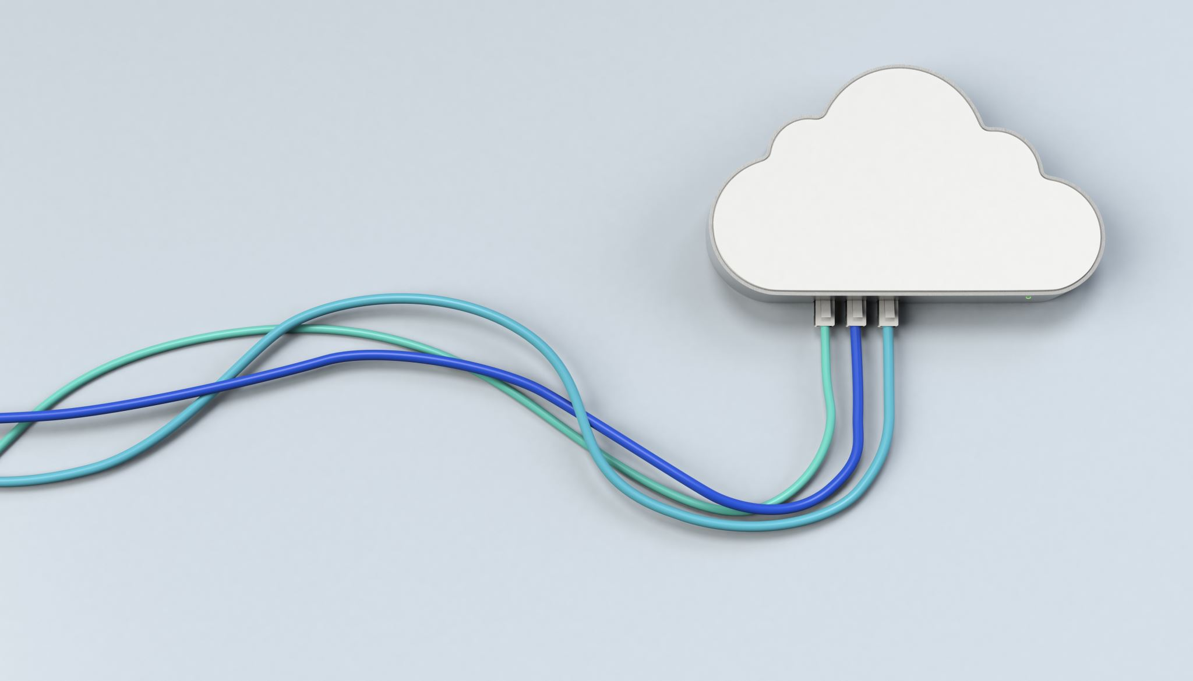

Cloud Computing Technology

Slide 2

Contents
Managed Service Providers
Cloud Service Providers
Data Center Virtualization
Virtualization
Data Center

Slide 3
Contents
Service Oriented Architecture
Open Source Softwares
Cloud Data Center
Microservice Architecture

Slide 4
Managed Service Provides
Provide and manage our IT services and functions
Delivers services for network, application, infrastructure and security via ongoing and regular support
Take care of issues that are often done in-house, such as security operations, encryption, infrastructure development, and any other IT functions.
benefit of 24/7 security monitoring and business IT support
MSP - IBM, Infosys, Wipro, Accenture

Slide 5
Services Of MSP
Data backup and recovery
Email server hosting
System management
Network monitoring
Applying security updates

Slide 6
Benefits of MSP
Help an organization fill staff shortages
Provide expertise
Provide business continuity
Provide constant network monitoring
Improve security
Improve cost efficiency

Slide 7
Cloud Service Provider
Provides on-demand services
Services are delivered and accessed via the Internet
Provide services via public, private or hybrid model
CSP – AWS, Azure, Google Cloud Platfor

Slide 8
Services Of CSP
SaaS
PaaS
IaaS

Slide 9
MSP vs CSP
MSP
MSP monitors and manages on premises technologies I.e. in-house and hosted within our premises
Capability to work closely with our staffs to cover IT needs
MSP manages technology and infrastructure that we own
MSP are well positioned to provide hands-on-support to the actual users of the system and services
CSP
CSP is off –premise cloud-based solutions
Hands off approach to customer relationships
Can't access device level issues on your end
CSP offers access to technology and services that they own

Slide 10

Virtualization
What does a server/PC consist ?
Processor, RAM, ROM, Network
What to do if server is not used based on its capacity fully ?
Virtualization
Process of creation of virtual machine not actual version of server, desktop
Software or program used to create a virtual machine in physical machine – Hypervisor (VMM –Virtual Machine Monitor )
Monitor all virtual machine - Hypervisor
Virtual machines uses the resources of a server based on configuration

Slide 11
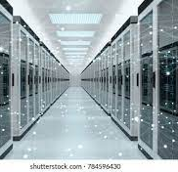
Data Center
Facility where organization or service provider centralizes their computing resources
Ranges from routers, security devices, storage system, servers and application delivery controllers
Ventilation, cooling systems, uninterruptible power supplies, backup generators

Slide 12
Data Center Virtualization
Conversion of hardware devices in a data center into software resources
Dividing all the hardware components to different virtual systems

Slide 13
Benefits Of Data Center Virtualization
Reduce
Reduce capital and operating costs
Deliver
Deliver high appication availability
Improve
Improve business continuity
Increase
Increase productivity
Improve
Improve responsiveness

Slide 14
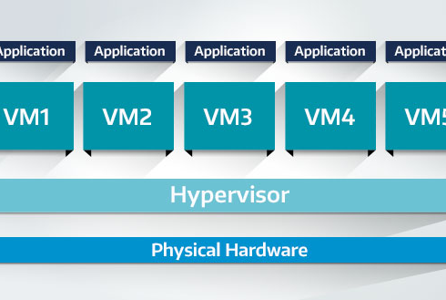
Virtualization

Slide 15
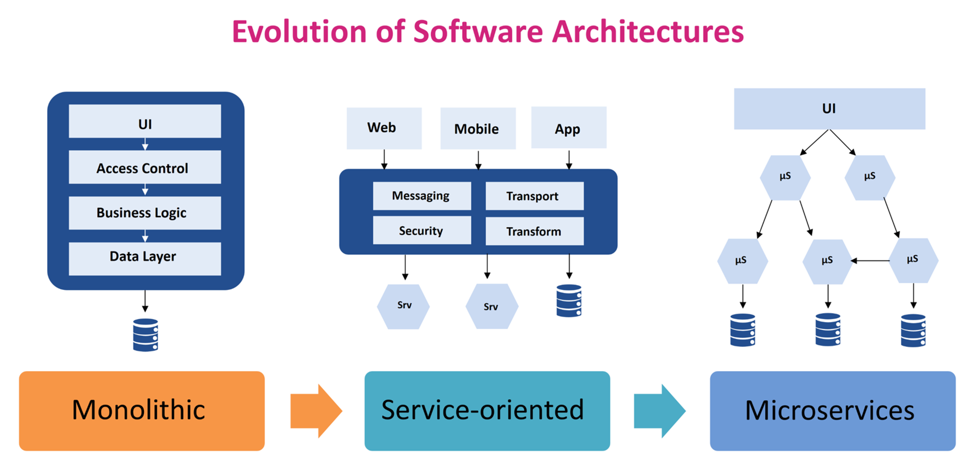
Software Architectures

Slide 16

Service Oriented Architecture (SOA)
Architecture not a technology, focusing on enterprise applications
Provides architectural framework where multiple services can communicate with each other
Concept of a design pattern helping to build distributed systems that deliver services to other applications through different protocols

Slide 17
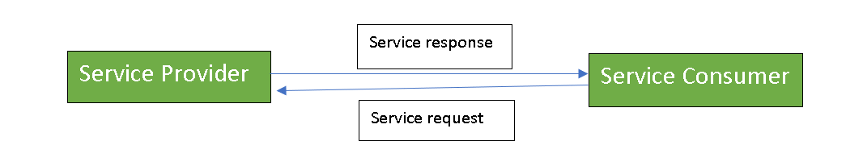
SOA
Loosely coupled architecture
Dependency of one system with another is minimal
Failure of one system doesn’t impact that of other
Doesn't limit to any programming language or platform

Slide 18
SOA
Service Consumer
Sends response to particular provider
Can be a different service or an end user application
Service Provider
Sends response to particular provider
Service broker
Makes information regarding the service available to those requesting it

Slide 19
Advantages
Service reusability
Can build a new application by reusing the service of existing one
Platform independent
Application built in different technology can be used
Reliability
Can debug different service easily so more reliable
Scalability
Single service can run on different environment

Slide 20
Disadvantages
High Cost
Different technology is used which can be costly for development and deployment cases
Can be Hassle
Time Consuming
While transferring heavy data from one service to another
Managing multiple service can be a complex tasks

